Slide 1
Human/Obstacle Following Robot
Sabrina Yesmin
Sadia Ahmed, Sanjida Ahmed

Slide 2
What is Human Following Robot?
This project attempts to make a robot that will follow the human or objects. For this Infrared sensors are used to move robot left and right and ultrasonic sensor is used to move robot forward and backward.
The brain of this robot is microcontroller Arduino Uno. The robot is driven by DC gear motors to control the movement of the wheels. The Arduino Uno interface is used to perform and implement algorithms to control the speed of the motors, steering the robot to travel smoothly.
The main motive of designing such type of robot is that technology can be made so much convenient that it will makes our lives better. If we utilize this technology in the car or any conveyance it will automatically sense the obstacles, then it will take a side of the available free space and we can drive safely.

Slide 3
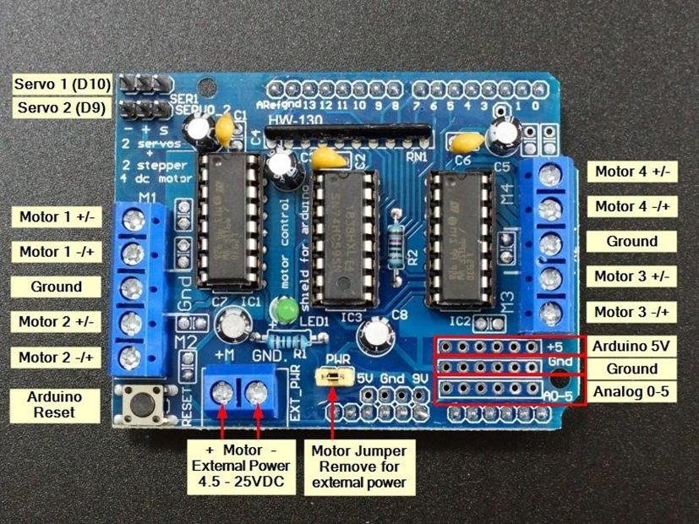

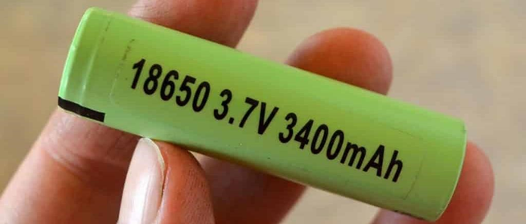
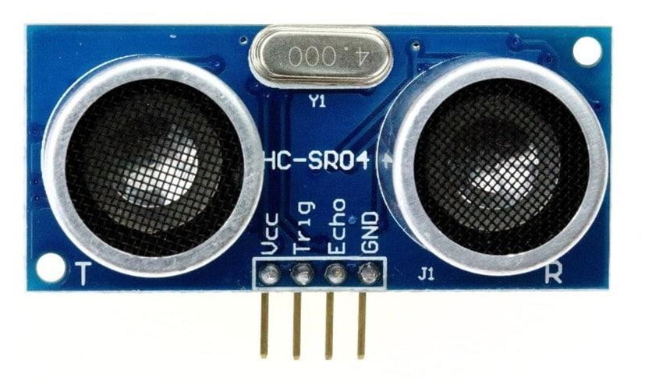
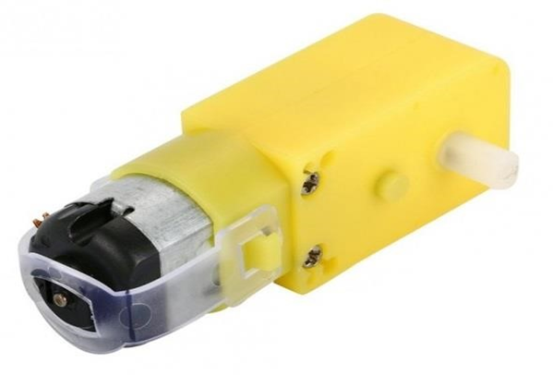
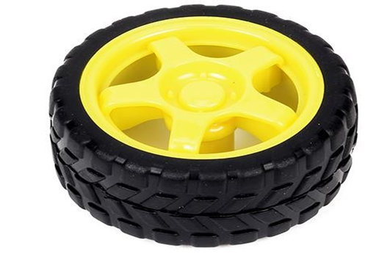
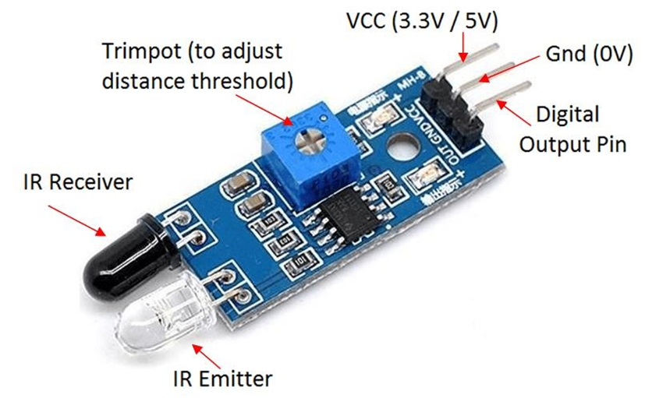
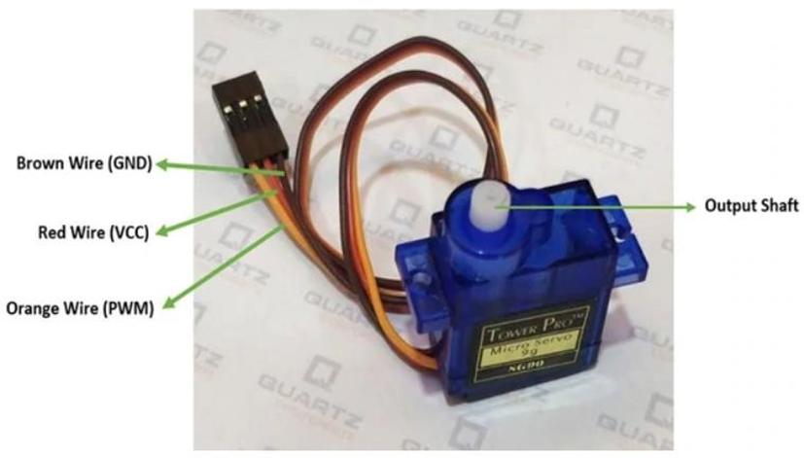
SYSTEM COMPONENTS

Slide 4
Arduino Uno
Arduino Uno is a microcontroller board based on the ATmega328P (datasheet). It has 14 digital input/output pins (of which 6 can be used as PWM outputs), 6 analog inputs, a 16 MHz ceramic resonator (CSTCE16M0V53-R0), a USB connection, a power jack, an ICSP header and a reset button. It contains everything needed to support the microcontroller; simply connect it to a computer with a USB cable or power it with a AC-to-DC adapter or battery to get started..

Slide 5
Motor driver
The L293D is a dual H-bridge motor driver integrated circuit (IC) designed to drive and control DC motors, stepper motors, and other actuators. An "L 293D motor shield" is a hardware expansion board designed to interface with an Arduino microcontroller board, making it easier to control and drive motors using the L 293D IC. The motor shield provides additional power outputs, control signals, and interface connections for connecting and controlling motors, and can simplify the wiring and setup of motor control projects.

Slide 6
Ultrasonic sensor
What is an Ultrasonic Sensor?
An ultrasonic sensor is an instrument that measures the distance to an object using ultrasonic sound waves. An ultrasonic sensor uses a transducer to send and receive ultrasonic pulses that relay back information about an object’s proximity. High-frequency sound waves reflect from boundaries to produce distinct echo patterns.
How Ultrasonic Sensors Work
Ultrasonic sensors work by sending out a sound wave at a frequency above the range of human hearing. The transducer of the sensor acts as a microphone to receive and send the ultrasonic sound. Our ultrasonic sensors, like many others, use a single transducer to send a pulse and to receive the echo. The sensor determines the distance to a target by measuring time lapses between the sending and receiving of the ultrasonic pulse.

Slide 7
IR Sensor
The IR sensor or infrared sensor is one kind of electronic component, used to detect specific characteristics in its surroundings through emitting or detecting IR radiation. These sensors can also be used to detect or measure the heat of a target and its motion. In many electronic devices, the IR sensor circuit is a very essential module. This kind of sensor is similar to human’s visionary senses to detect obstacles. The sensor which simply measures IR radiation instead of emitting is called PIR or passive infrared. Generally in the IR spectrum, the radiation of all the targets radiation and some kind of thermal radiation are not visible to the eyes but can be sensed through IR sensors.

Slide 8
Why we've used both sensor
When choosing the sensor, there are a lot of things to take in consideration, so that you can determine the right way to go.
Accuracy – How close the reading is to the true distance.
Resolution – The smallest reading or change in readings that can be reported.
Precision – The smallest reading that can be taken repeatedly and reliably.
External factors - Like sunlight that affects IR sensors, or sound absorving materials that give an hard time to ultrasonic sensors.
The biggest difference between IR sensor vs. ultrasonic sensors is the way in which the sensor works. Ultrasonic sensors use sound waves (echolocation) to measure how far away you are from an object. On the other hand, IR sensors use Infrared light to determine whether or not an object is present.
Accuracy and reliability are also big differentiators in these sensors. Most often, ultrasonic sensors will provide you more reliable and accurate data than IR sensors. If you want an accurate, numerical representation of distance for your project, I’d almost always choose an Ultrasonic sensor.
However, if you only need to know if an object is present or not, then an IR sensor is easier to implement. Now, let’s talk a little bit more about both of these sensors and their technical specifications.

Slide 9
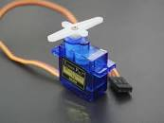
Servo Motor
A servo motor is a type of motor that can rotate with great precision. Normally this type of motor consists of a control circuit that provides feedback on the current position of the motor shaft, this feedback allows the servo motors to rotate with great precision. If you want to rotate an object at some specific angles or distance, then you use a servo motor. It is just made up of a simple motor which runs through a servo mechanism. If motor is powered by a DC power supply then it is called DC servo motor, and if it is AC-powered motor then it is called AC servo motor. For this tutorial, we will be discussing only about the DC servo motor working. Apart from these major classifications, there are many other types of servo motors based on the type of gear arrangement and operating characteristics. A servo motor usually comes with a gear arrangement that allows us to get a very high torque servo motor in small and lightweight packages. Due to these features, they are being used in many applications like toy car, RC helicopters and planes, Robotics, etc.

Slide 10
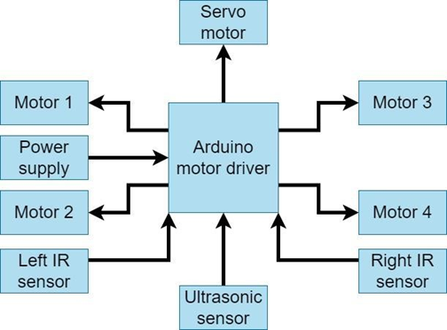
Hardware Block Diagram

Slide 11
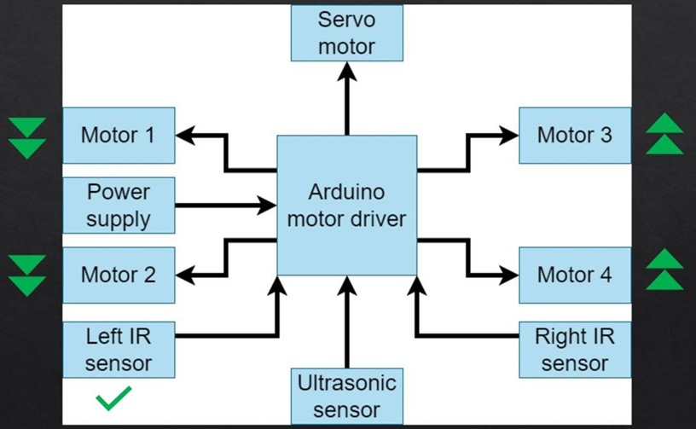
Go forward

Slide 12
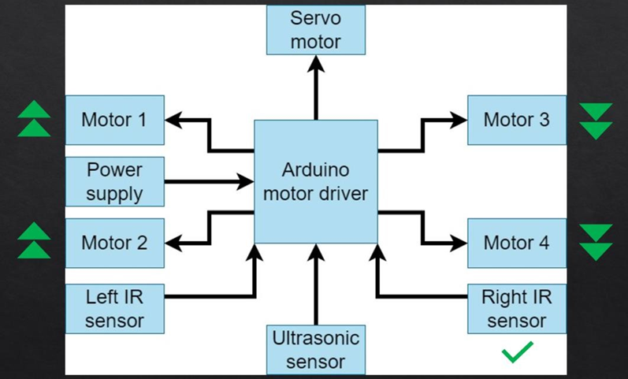
Turn Right

Slide 13

Turn Left

Slide 14
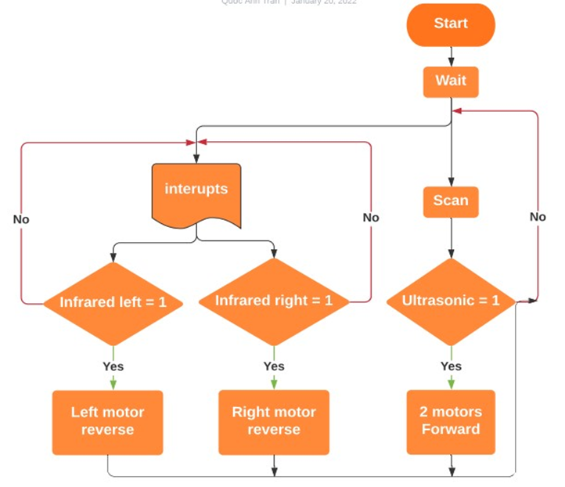
Flow Chart

Slide 15
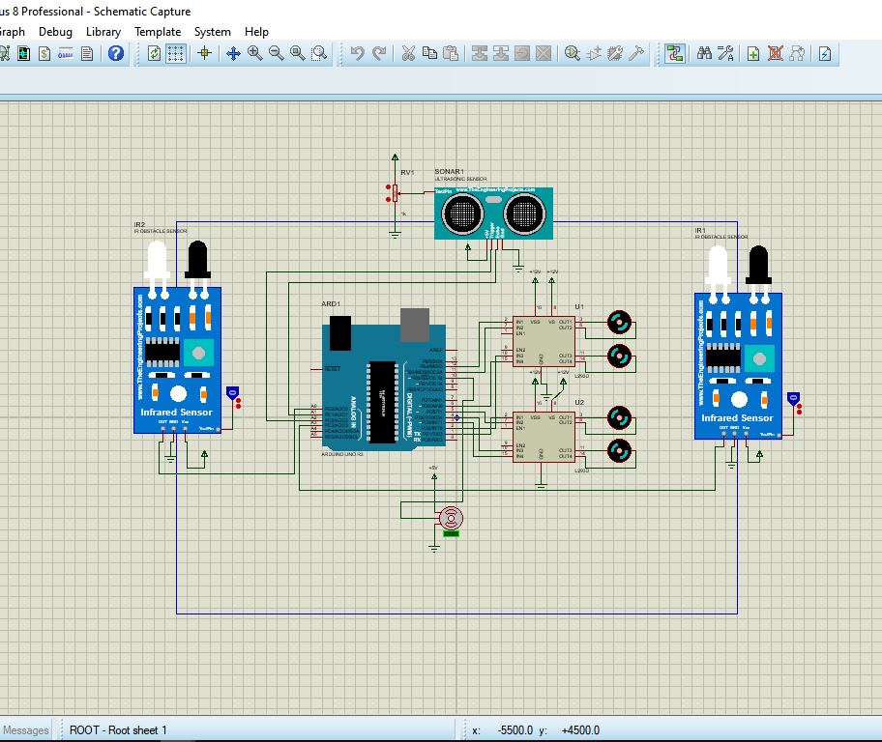
Proteus diagram

Slide 16
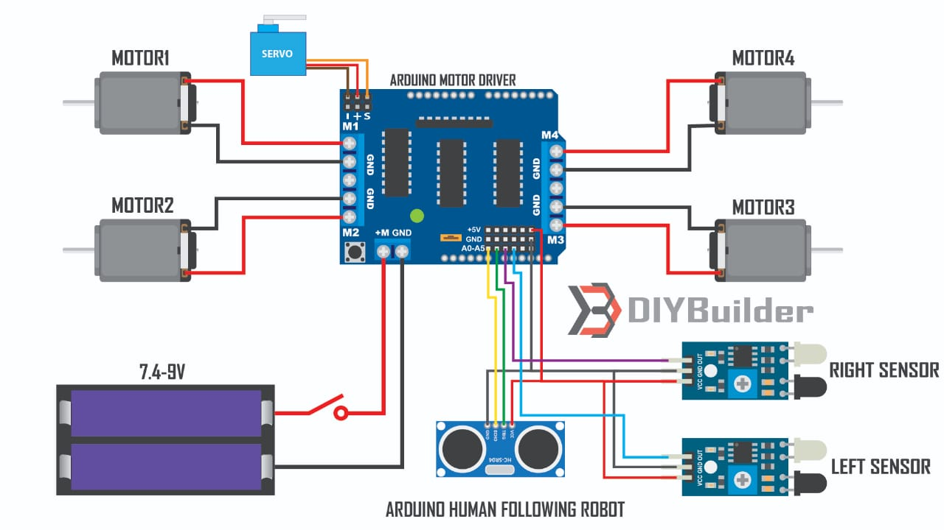
Circuit diagram

Slide 17
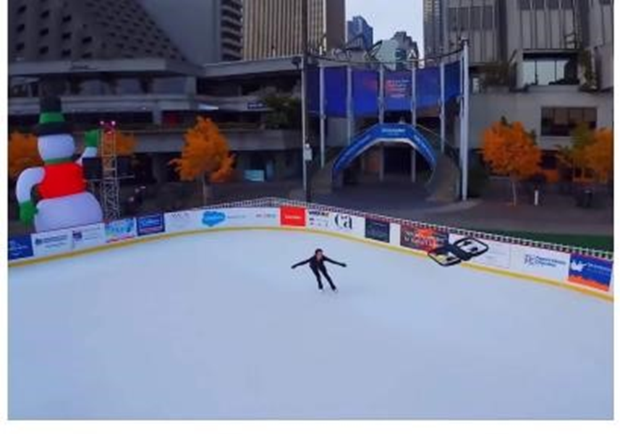
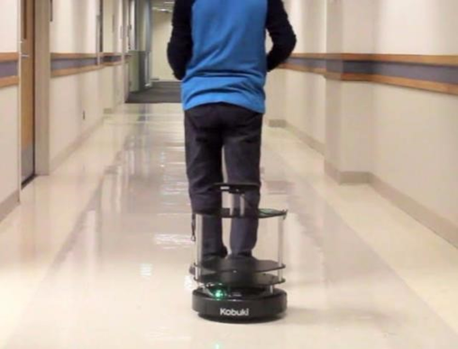
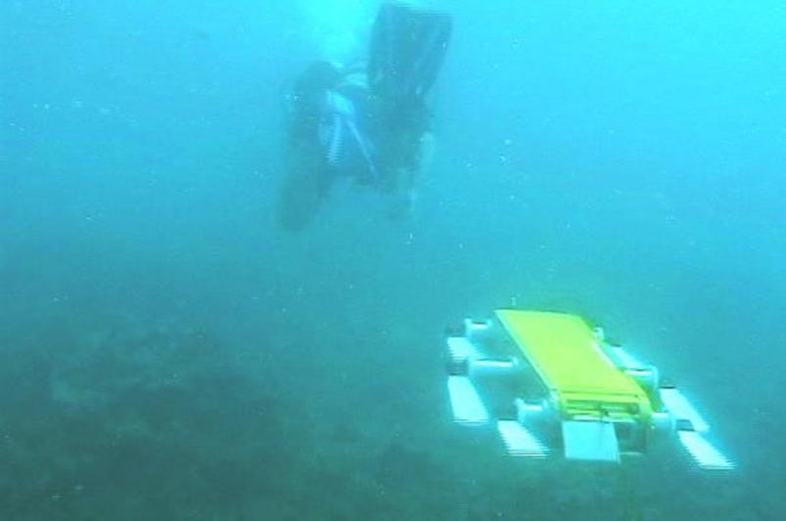
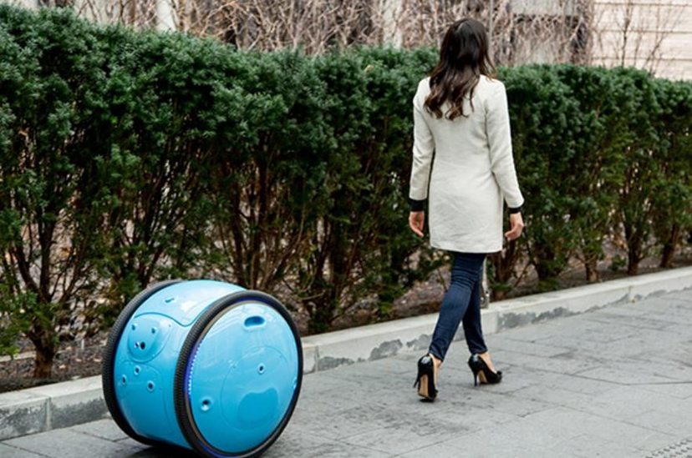
Documentation
Documentation

Slide 18
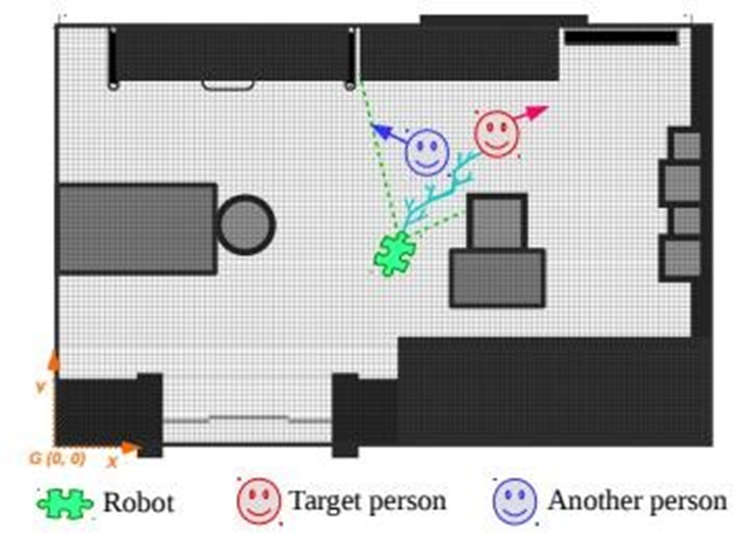
Difficulty
Suppose there are two targets like target A and target B. First, the robot is following target A and suddenly target B passes between the robot and target A. At that time the robot will lose the track of target A and detect target B. Finally the robot will switch to follow target B instead of the original target which is A.

Slide 19
Thank you
Prepared by
C211207- Sabrina Yesmin
C211225- Sadia Ahmed
C211226- Sanjida Ahmed

